Slide 1
BRAKES

Slide 2
COMPONENTS:
Break pedal
Balance Bar
Master Cylinders
Reservoirs
Brake Callipers
Brake Pads

Slide 3

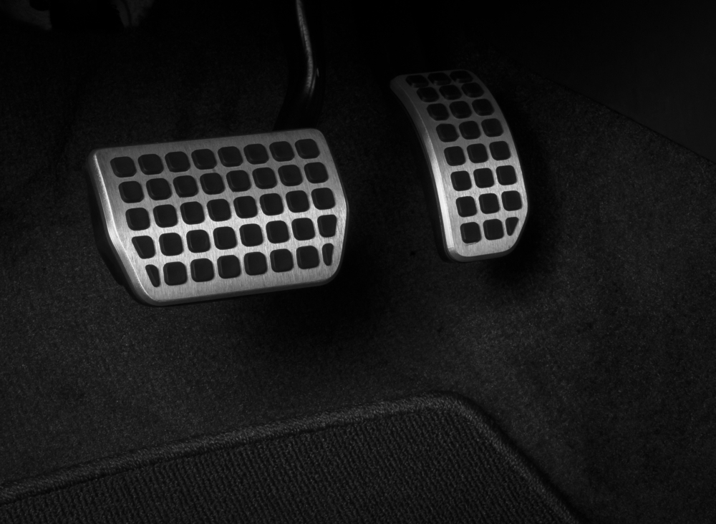
Break pedal
Break pedal
Accelarator
The brake pedal is the pedal in a motor vehicle that is pressed with the driver's right foot to slow down or stop the vehicle. It is typically located to the right of the accelerator pedal.
The brake pedal is connected to the vehicle's braking system, which uses hydraulic pressure to slow down the wheels. When the driver presses on the brake pedal, a piston in the brake master cylinder forces brake fluid through brake lines to the calipers at each wheel. The calipers squeeze the brake pads against the rotors or drums, which creates friction that slows down the wheels.

Slide 4
Break pedal
Break pedal has two important characteristics:
Pedal Ratio
Brake Bias

Slide 5
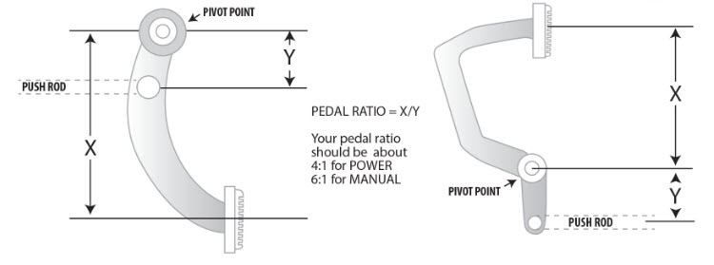
Pedal ratio
Pedal ratio refers to how much the force you apply to the brake pedal gets multiplied before it reaches the brakes. In simpler terms, it tells you how hard you need to press the pedal to achieve a certain braking force.
Here's how it works:
The pedal has a pivot point.
You press the pedal on one side of the pivot point (usually with your foot on the pad).
A pushrod connects to the other side of the pivot point and transfers the force to the master cylinder.
The pedal ratio is calculated by dividing the distance from the pivot point to the center of the pedal pad (distance X) by the distance from the pivot point to the center of the master cylinder pushrod (distance Y).
So, pedal ratio = X / Y.

Slide 6
Brake bias
Brake bias, also known as brake balance, refers to the distribution of braking force between the front and rear wheels of a vehicle. It's typically expressed as a percentage of braking force applied to the front wheels.
Here's how it works:
Weight transfer: When you brake, the car's weight transfers forward, putting more weight on the front wheels and reducing weight on the rear wheels.
Unequal braking force: To compensate for this weight transfer and maintain vehicle stability, the front brakes are designed to apply more stopping power than the rear brakes.
Factors affecting brake bias:
Vehicle type: FWD cars naturally have more weight on the front wheels, so they need a higher front brake bias.
Driving conditions: Race cars might need adjustments for optimal performance on a track.
Cargo and passenger weight: A heavier load can shift the weight distribution and require a slight bias adjustment.
Adjusting brake bias:
In most everyday vehicles, brake bias isn't adjustable. However, some high-performance cars might have features for fine-tuning the balance. It's important to leave adjustments to qualified mechanics as improper settings can be dangerous.

Slide 7
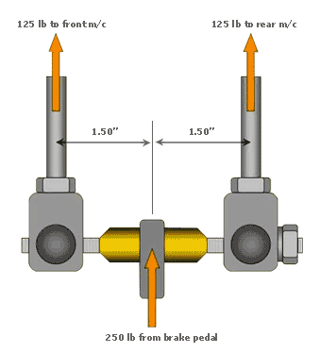
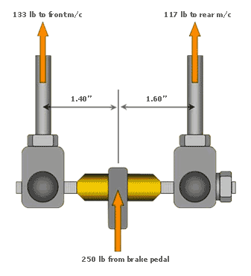
Balance bar
Brake bias is changed by adjusting the balance bar which lies between the brake pedal and master cylinders.

Slide 8
Master cylinders
The master cylinder is the commander of your car's braking system. It's a seemingly simple but crucial component that translates your leg force on the brake pedal into hydraulic pressure that activates the brakes at each wheel. Here's a deeper dive into how it works:
The Force Multiplier:
Imagine the master cylinder as a hydraulic press. When you press the brake pedal, it pushes a piston within the master cylinder. This piston applies pressure to the brake fluid, a non-compressible liquid filling the cylinder and brake lines. Since pressure acts equally in all directions within a sealed system (like the brake fluid), the force you exert on the pedal gets multiplied as it's transferred to the brake fluid.
From Pedal to Pressure:
The master cylinder has two main parts:
Reservoir: This is a container that holds the brake fluid. It also has a small opening that allows air to enter the system when the brake pedal is released.
Piston and Cylinder Bore: The piston is a tight-fitting disc inside a cylindrical bore. When you press the pedal, the piston pushes against the brake fluid in the bore, forcing it out towards the brakes.

Slide 9
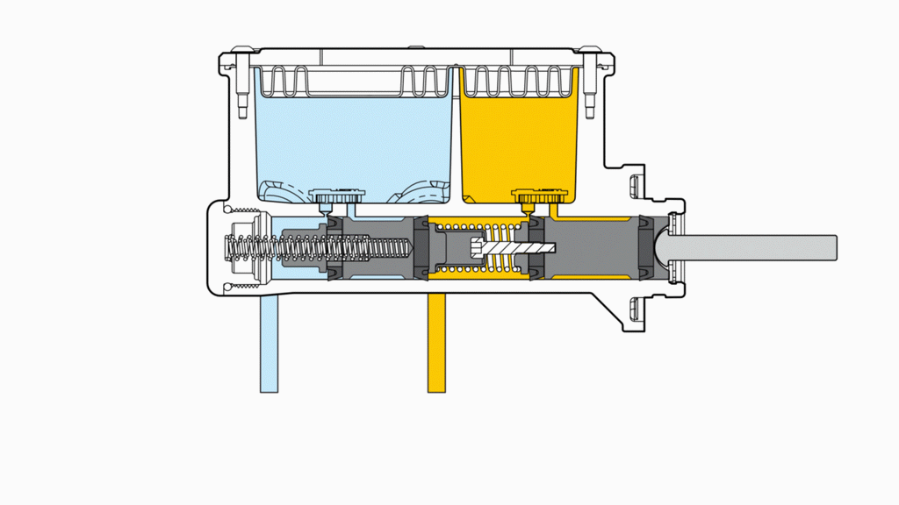
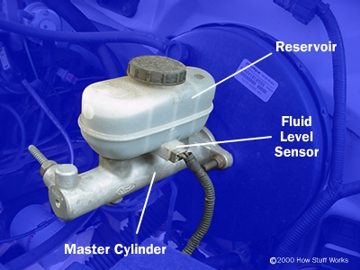
Master cylinder working

Slide 10
Brake callipers and Brake pads
Brake calipers are crucial components in a vehicle's disc brake system, which is the most common type of brake system used today. Unlike brake cylinders which are specific to drum brakes, calipers are essential for squeezing the brake pads against the disc-shaped rotors to slow down the wheels.
Here's a breakdown of how brake calipers work:
Hydraulic Pressure: When you press the brake pedal, the master cylinder pressurizes the brake fluid which is then transmitted through brake lines.
Force Transfer: The brake caliper houses pistons (usually one or more depending on the design) that are directly impacted by the pressurized brake fluid.
Squeezing the Pads: The force from the pistons pushes the brake pads inwards against the rotor.
Friction Generation: The friction between the high-friction material of the brake pads and the smooth surface of the rotor creates the stopping power that slows down the wheel.
Brake pads are the workhorses of your car's disc brake system. They're the parts that come into direct contact with the spinning discs (rotors) to slow down the wheels and ultimately the vehicle.

Slide 11
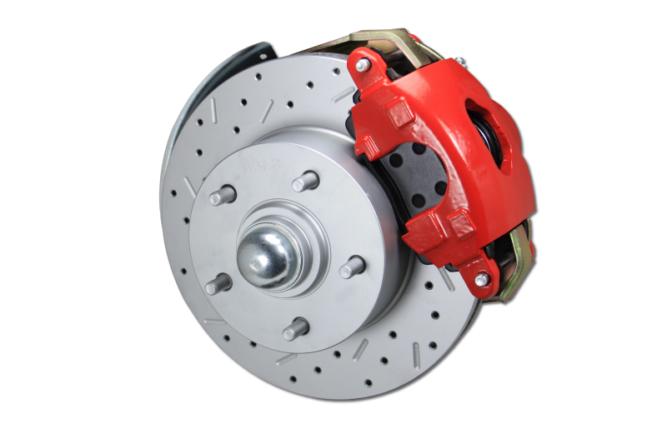
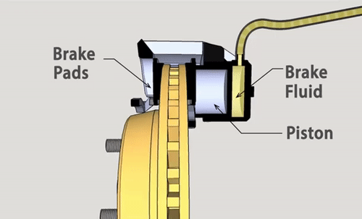
Brake callipers and Brake pads
Rotor
Callipers
Brake pads

Slide 12
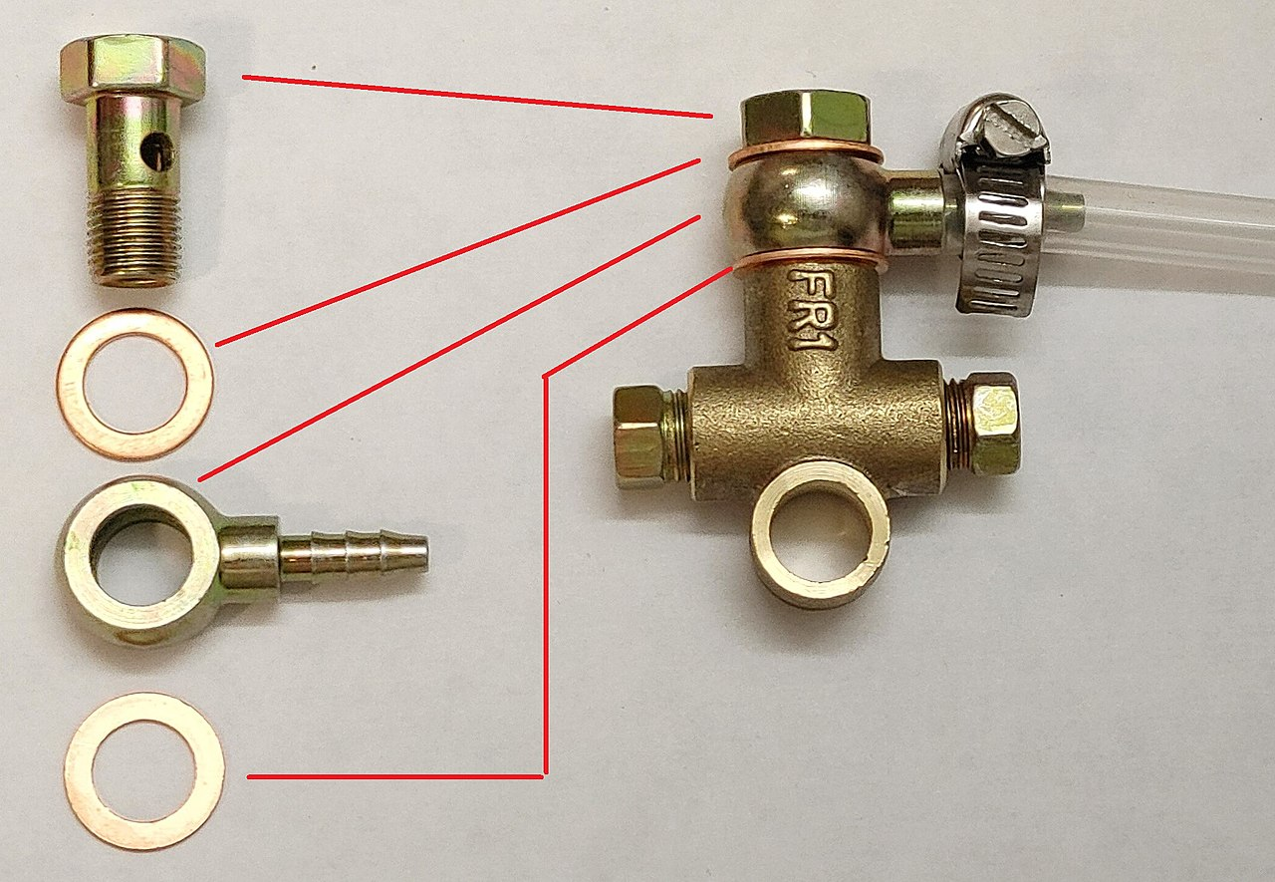
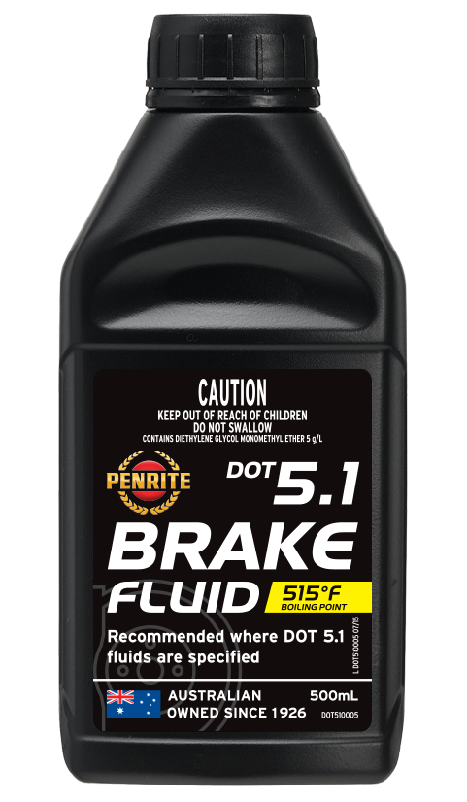
Some other components:
Banjo bolt
A banjo bolt is a specific type of bolt used to create a connection between a hose and a threaded component. Banjo bolts are most commonly used in hydraulic systems, which transfer fluid power. They are also used in lubrication systems, fuel systems, and brake systems.
Brake fluid
Brake fluid is a hydraulic fluid that plays a vital role in your car's braking system. It's a hygroscopic fluid, meaning it absorbs moisture from the surrounding air. This moisture absorption is important because it helps prevent corrosion within the brake system. However, too much moisture can lower the boiling point of the brake fluid, which can lead to brake failure.

Slide 13
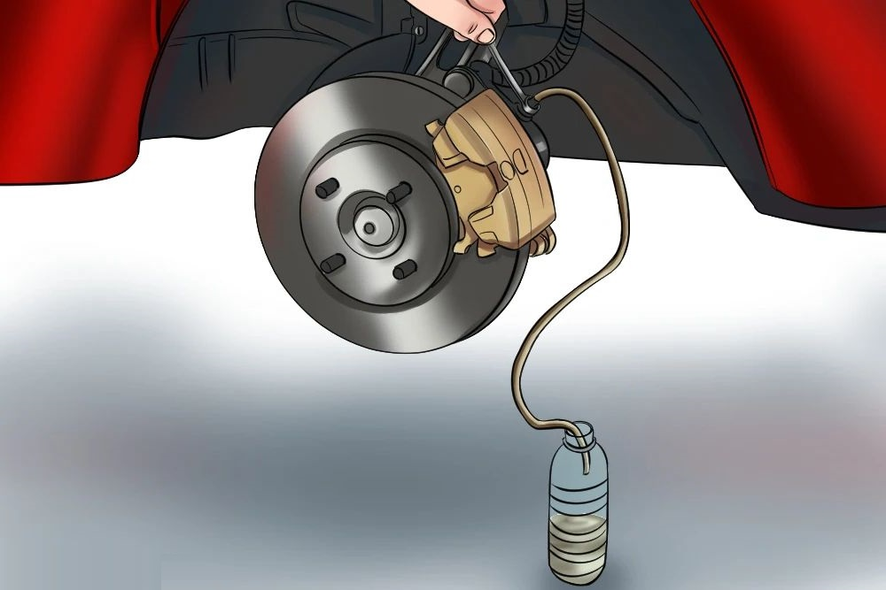
Brake bleeding
Brake bleeding is the process of removing air bubbles from your car's hydraulic brake system. Air is compressible, whereas brake fluid is not. If air gets into the system, it can create a spongy brake pedal and reduce braking performance. This can be dangerous.
There are two main methods for bleeding brakes:
Pump and hold method: This is the traditional method where one person pumps the brake pedal while another opens and closes the bleeder screws to expel air bubbles.
Vacuum method: This method uses a vacuum pump to suck out the fluid and air bubbles from the bleeder screws.

Slide 14
WHEEL ASSEMBLY

Slide 15
Main Components:
Upright
Hubs
UBJ

Slide 16
Upright
In the context of brakes, the upright is also called a spindle or steering knuckle. It's a critical vehicle component, especially for suspension, steering, and braking systems.
Here's how the upright is involved in braking:
Mounting point: The brake caliper, which houses the brake pads that clamp onto the disc rotor to slow down the wheel, is bolted onto the upright.
Strength and stability: During braking, significant forces are exerted. The upright needs to be strong and rigid enough to handle these forces and maintain the proper alignment between the wheel and the rest of the suspension system.

Slide 17
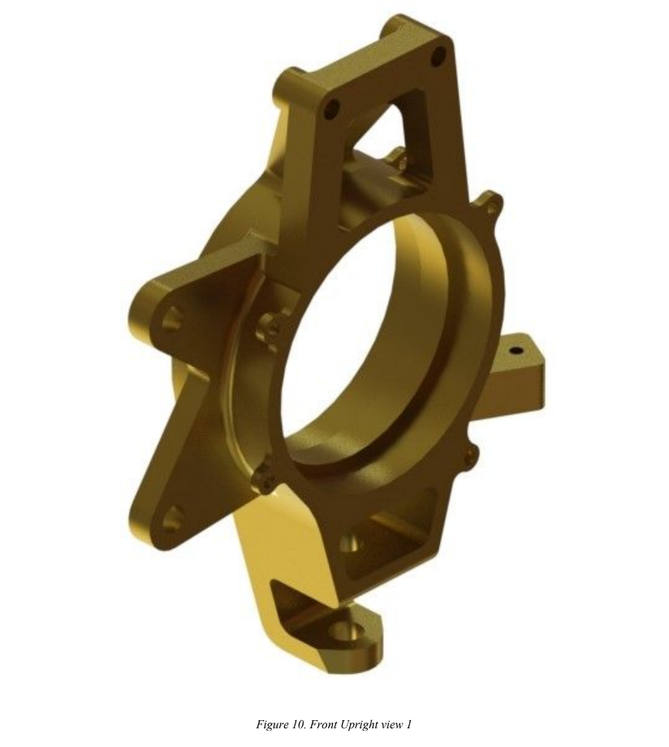
This is where UBJ is attached.
Shims (aluminium sheets) are added between UBJ and upright to adjust the camber.
This is where hub goes into.
This is where brake callipers are attached
Tie rod mount.
This is where the tie rod is attached.
The tie rod connects upright to the steering wheel.
This is LBJ.

Slide 18
Hub
The hub is the primary rotating part of the wheel assembly, which connects the drive shafts to the wheels. The primary functions of the hubs are as follows :
❖ As already mentioned, Hubs are mounted into the uprights using deep groove ball bearings, thus enabling the rotation of the wheel. Such assembly allows the conversion of the rotational loads to translational loads.
❖ Proper bearing abutments were ensured through bearing caps, steps and spacers. Reliability is a primary factor of consideration here.
❖ Wheels are mounted on the hub with four drive pegs and a centre lock nut. Drive pegs help transfer the rotational load (torque) between the wheel and the hub, while the centre lock nut ensures that the wheel is in position with the hubs.
❖ It acts as a mounting point for brake disks and takes braking torque considerably high in the front. Brake Disks are mounted using four Floater Buttons and circlips.
❖ Torque is transferred via a tripod joint to the rear hub. Since the tripod is a rotating steel component, it will wear out the hub if made of softer material. Hence, thin inserts were made of steel to reduce weight and protect them from wear. An OEM tripod housing was reverse-engineered into a CAD model and was integrated into the rear hub.

Slide 19
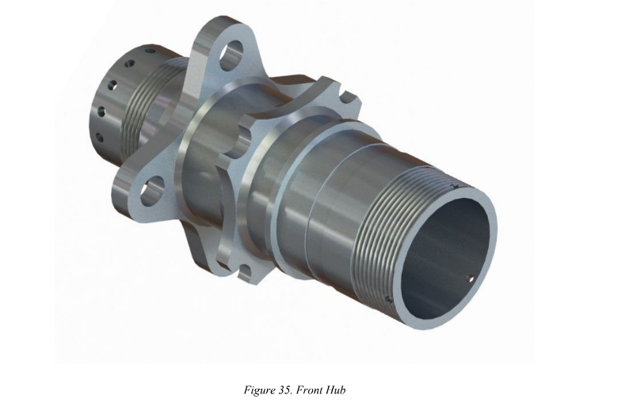
This is where the wheel nut is secured.
This is used to secure the brake rotor.
This is where deep groove ball bearings are present between the hub and upright.
This is where the centre lock nut is secured.
This is where drive pegs are inserted. The drive pegs go into the rim of the wheel. The drive pegs are the ones that transmit torque.

Slide 20
UBJ (Upper Ball Joint)
UBJ clamp is like an extension of the front upright, which is used to bolt the upper A-arms
through a spherical ball bearing. Since we have a high kingpin angle the UBJ point is
considerably away from the LBJ. Making a separate clamp reduces the machining and
material costs.
Its main design features are:
❖ Since the tyre is permitted to move an inch above and below its normal position during
Run, the design has to accommodate this movement as the A-arm should not collide with
The clamp
❖ High loads around 3kN are transferred from the UBJ clamp to A-arms; hence it should be
Strong enough.
❖ For tuning the car, the camber change is made possible by the UBJ clamp. Shims are
Added between it and the upright to facilitate this.

Slide 21
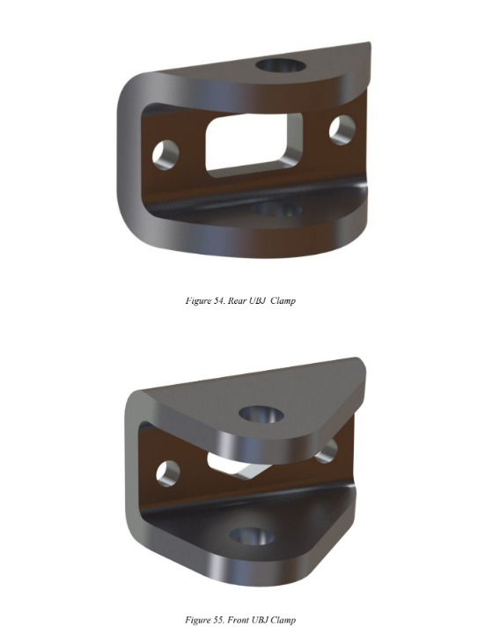
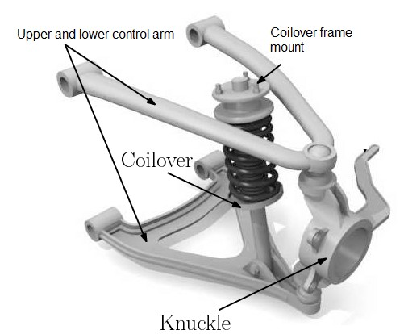
UBJ
Upright
LBJ

